Slide 1

CHAPTER 11 I/O Management and Disk Scheduing
Instructor: Wuman LUO
luowuman@ipm.edu.mo
Office: A213
14:30-17:30 Tuesday & Wednesday

Slide 2
Differences in I/O Devices
Data transfer rate
Application
Complexity of control
Unit of transfer – data may be transferred as
a stream of bytes (e.g. terminal), stream-oriented
in larger blocks (e.g. disk), block-oriented
Data representation
Error conditions
Notes:
There are great differences across classes and even substantial differences within each class. Among the key differences are the following:
• Data rate: There may be differences of several orders of magnitude between the data transfer rates. Figure 11.1 gives some examples.
• Application: The use to which a device is put has an influence on the software and policies in the operating system and supporting utilities. For example, a disk used for files requires the support of file management software. A disk used as a backing store for pages in a virtual memory scheme depends on the
use of virtual memory hardware and software. Furthermore, these applications have an impact on disk scheduling algorithms (discussed later in this chapter). As another example, a terminal may be used by an ordinary user or a system administrator. These uses imply different privilege levels and perhaps different priorities in the operating system.
• Complexity of control: A printer requires a relatively simple control interface. A disk is much more complex. The effect of these differences on the operating system is filtered to some extent by the complexity of the I/O module that controls the device, as discussed in the next section.
Unit of transfer: Data may be transferred as a stream of bytes or characters
(e.g., terminal I/O) or in larger blocks (e.g., disk I/O).
• Data representation: Different data encoding schemes are used by different devices, including differences in character code and parity conventions.
• Error conditions: The nature of errors, the way in which they are reported, their consequences, and the available range of responses differ widely from one device to another.
This diversity makes a uniform and consistent approach to I/O, both from the point of view of the operating system and from the point of view of user processes, difficult to achieve.

Slide 3
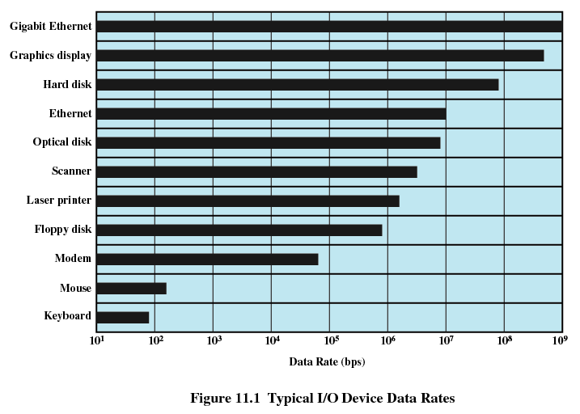
Typical I/O Devices Data Rates
3

Slide 4
Performing I/O
Programmed I/O
Process is busy-waiting for the operation to complete
Interrupt-driven I/O
I/O command is issued
Processor continues executing instructions
I/O module sends an interrupt when done

Slide 5

Performing I/O
Direct Memory Access (DMA)
DMA module controls exchange of data between main memory and the I/O device
Processor interrupted only after entire block has been transferred

Slide 6
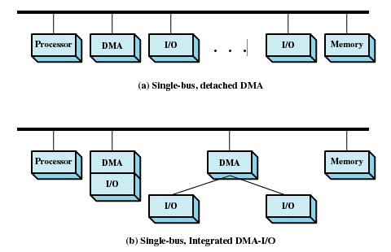
DMA Configurations
6
Notes:
The DMA mechanism can be configured in a variety of ways. Some possibilities are shown in Figure 11.3 . In the first example, all modules share the same system bus. The DMA module, acting as a surrogate processor, uses programmed I/O to exchange data between memory and an I/O module through the DMA module. This configuration, while it may be inexpensive, is clearly inefficient: As with processor-controlled programmed I/O, each transfer of a word consumes two bus cycles (transfer request followed by transfer).
The number of required bus cycles can be cut substantially by integrating the DMA and I/O functions. As Figure 11.3b indicates, this means that there is a path between the DMA module and one or more I/O modules that does not include the system bus. The DMA logic may actually be a part of an I/O module, or it may be a separate module that controls one or more I/O modules.

Slide 7
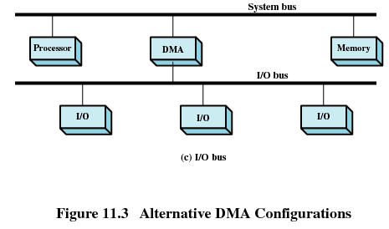
DMA Configurations
In both (b) and ©, the exchange of data between the DMA and I/O modules takes place off the system bus.
7
Notes:
This concept can be taken one step further by connecting I/O modules to the DMA module using an I/O bus ( Figure 11.3c ). This reduces the number of I/O interfaces in the DMA module to one and provides for an easily expandable configuration. In all of these cases ( Figure 11.3b and 11.3c ), the system bus that the DMA module shares with the processor and main memory is used by the DMA module only to exchange data with memory and to exchange control signals with the processor. The exchange of data between the DMA and I/O modules takes place off the system bus.

Slide 8
Techniques for Performing I/O
No Interrupts
Use of Interrupts
I/O-to-memory transfer through processor
Programmed I/O
Interrupt-driven I/O
Direct I/O-to-memory transfer
DMA
8

Slide 9
I/O Buffering
Reasons for buffering
Processes must wait for I/O to complete before proceeding
Certain pages must remain in main memory during I/O
I/O device
Addressing space of a process
s1
Chap …
s2
………
Chap 11
Input / Output
…
…
...
fgets(F,s1)
fgets(F,s2)
...
z➔
9
Notes:
The same considerations apply to an output operation. If a block is being transferred from a user process area directly to an I/O module, then the process is blocked during the transfer and the process may not be swapped out.
To avoid these overheads and inefficiencies, it is sometimes convenient to perform input transfers in advance of requests being made and to perform output transfers some time after the request is made. This technique is known as buffering. In this section, we look at some of the buffering schemes that are supported by operating systems to improve the performance of the system.
In discussing the various approaches to buffering, it is sometimes important to make a distinction between two types of I/O devices: block oriented and stream
oriented. A block-oriented device stores information in blocks that are usually of fixed size, and transfers are made one block at a time. Generally, it is possible to reference data by its block number. Disks and USB keys are examples of block oriented devices. A stream-oriented device transfers data in and out as a stream of bytes, with no block structure. Terminals, printers, communications ports, mouse and other pointing devices, and most other devices that are not secondary storage are stream oriented.

Slide 10
How I/O Buffer works, 1
I/O device
Addressing space of a process
I/O buffer
s1
………
Cha …
… … …
… … …
s2
………
Chap 11
Input / Output
…
…
...
fgets(F,s1)
fgets(F,s2)
...
z➔
To avoid these overheads and inefficiencies, it is sometimes convenient to perform input transfers in advance of requests being made and to perform output transfers sometime after the request is made. This technique is known as buffering.
OS reads data from I/O device to I/O buffer. User process reads from I/O buffer. (similar for data write)
I/O buffer is not swapped out.
10

Slide 11
How I/O Buffer works, 2
I/O device
Addressing space of a process
I/O buffer
s1
Chap 11
Chap 11
Input / Output
… … …
s2
………
Chap 11
Input / Output
…
…
Input/Output
...
fgets(F,s1)
fgets(F,s2)
...
➔
When the process requests the first line, it is blocked. A few lines will be read, in advance, from the I/O device to the I/O buffer. Later, when the process requests the second line, the OS can satisfy the request from the I/O buffer without blocking.
11

Slide 12
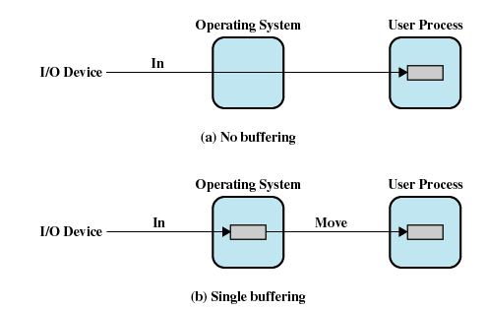
I/O Buffering
12
Notes:
The simplest type of support that the operating system can provide is single buffering ( Figure 11.5b ). When a user process issues an I/O request, the OS assigns a buffer in the system portion of main memory to the operation.
In the case of line-at-a-time I/O, the buffer can be used to hold a single line. The user process is suspended during input, awaiting the arrival of the entire line.
For output, the user process can place a line of output in the buffer and continue processing. It need not be suspended unless it has a second line of output to send before the buffer is emptied from the first output operation. In the case of byte-at-a-time I/O, the interaction between the OS and the user process follows the producer/consumer model discussed in Chapter 5 .

Slide 13
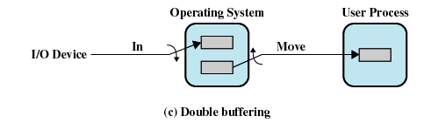
Double Buffer
Use two system buffers instead of one
A process can transfer data to or from one buffer while the operating system empties or fills the other buffer
13

Slide 14
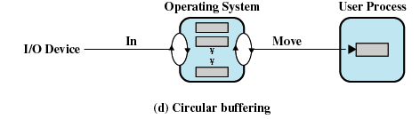
Circular Buffer
More than two buffers are used
Each individual buffer is one unit in a circular buffer
Used when I/O operation must keep up with process
14

Slide 15
Disk Scheduling
At runtime, I/O requests for disk tracks come from the processes
OS has to choose an order to serve the requests
Process A reads tracks 2, 5
OS has to read these tracks: 2,3,4,5,8.
Process B reads tracks 3, 5
Process C reads tracks 8, 4
15

Slide 16
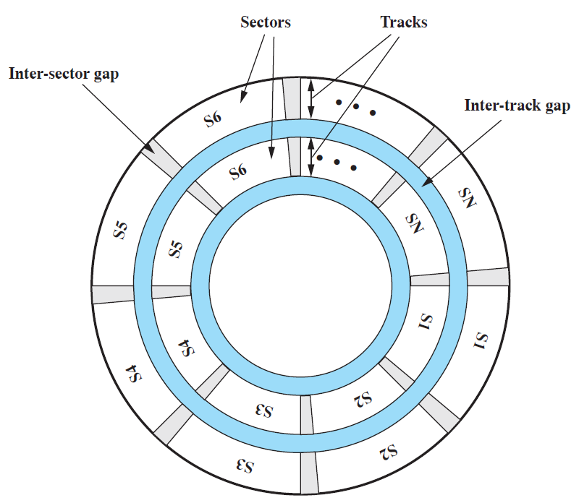
Disk Data Layout
16

Slide 17
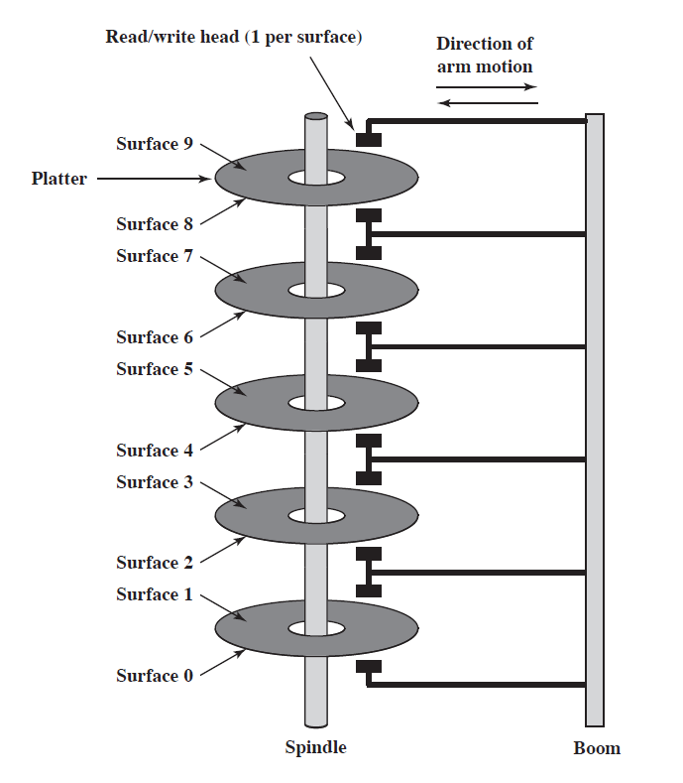
Components of a Disk Drive
17

Slide 18
Access time
Total access time = seek time + rotational delay + data transfer time
Seek time – time required to move the disk arm to the required track
Rotational delay – time required to rotate the disk to the required sector
Data transfer time – time to read/write data from/to the disk

Slide 19
Disk Scheduling
The order that the read/write head is moved to satisfy several I/O requests
determines the total seek time
affects performance
the OS cannot change the rotational delay or transfer time, but it can try to find a ‘good’ order that spends less time in seek time.
If requests are selected randomly, we will get the worst possible performance...

Slide 20
Disk Scheduling Policy
FIFO: fair, but near random scheduling
SSTF: possible starvation
SCAN: favor requests for tracks near the ends
C-SCAN
FSCAN: avoid “arm stickiness” in SSTF, SCAN and C-SCAN

Slide 21
First-in-first-out, FIFO
Process requests in the order that the requests are made
Fair to all processes
Approaches random scheduling in performance if there are many processes
Read write head starting at track 8, in the direction of increasing track number
8
1
2
7
10
Pending read/write request for a track
21

Slide 22
Shortest Service Time First, SSTF
Select the disk I/O request that requires the least movement of the disk arm from its current position
Always choose the minimum seek time
New requests may be chosen before an existing request
8
1
2
7
10
22

Slide 23
SCAN
Arm moves in one direction only, satisfying all outstanding requests until there is no more requests in that direction. The service direction is then reversed.
Favor requests for tracks near the ends
8
1
2
7
10
23
Notes:
Favor requests for tracks near the ends because the head move to the end and goes back.

Slide 24
C-SCAN
Restrict scanning to one direction only
When the last track has been visited in one direction, the arm is returned to the opposite end of the disk and the scan begins again.
8
1
2
7
10
24

Slide 25
FSCAN
“Arm stickiness” in SSTF, SCAN, C-SCAN in case of repetitive requests to one track
FSCAN uses two queues. When a SCAN begins, all of the requests are in one of the queues, with the other empty. During the scan, all new requests are put into the other queue.
Service of new requests is deferred until all of the old requests have been processed.

Slide 26
Example
Trace the policies FIFO, SSTF, SCAN, C-SCAN and FSCAN for the following disk requests. Each I/O request on a track takes 5 time units. At time 0, the disk starts reading track 10, and the read/write head was moving to the larger track number direction .
Time | 0 | 1 | 2 | 3 | 6 | 7
Request to access track .. | 10 | 19 | 3 | 14 | 12 | 9
 | Track access order | Average seek length
FIFO | 10,19,3,14,12,9 | (9+16+11+2+3)/5 = 8.2
SSTF | 10,14,12,9,3,19 | (4+2+3+6+16)/5 = 6.2
SCAN | 10,14,19,12,9,3 | (4+5+7+3+6)/5 = 5
C-SCAN | 10,14,19,3,9,12 | (4+5+16+6+3)/5 = 6.8
FSCAN | 10,14,19,3,9,12 | (4+5+16+6+3)/5 = 6.8
26

Slide 27
RAID
Redundant Array of Independent Disks
A set of physical disk drives viewed by the OS as a single logical drive
Data are distributed across the physical drives. May improve performance.
Redundant disk stores parity information. Recoverability, reliability.

Slide 28
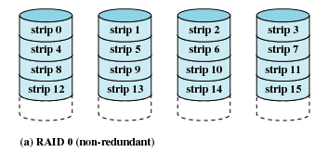
RAID 0 (Non-redundant)
The logical disk is divided into strips, mapped round robin to consecutive physical disks
Improve performance in disk read/write
Not fault tolerant
28

Slide 29
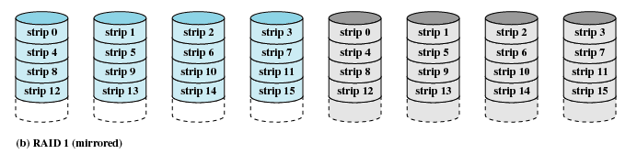
RAID 1 (Mirrored)
Each disk is mirrored by another disk
Good performance if the hardware supports concurrent read/write to the mirrored pair
Reliable, but expensive
29

Slide 30
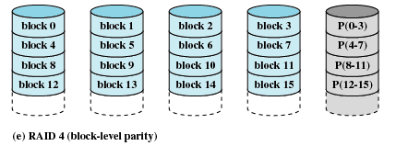
Parity strip
To compute the parity strip... P(0-3) := b0 ⊕ b1 ⊕ b2 ⊕ b3
Computed and updated at write, verified at read
Every write results in two read and two write of strips
A corrupted strip can be recovered
To recover the block 0... b0 = P(0-3) ⊕ b1 ⊕ b2 ⊕ b3
30
Notes:
levels 4 through 6 make use of an independent access technique. In an independent
access array, each member disk operates independently, so that separate
I/O requests can be satisfied in parallel. Because of this, independent access arrays
are more suitable for applications that require high I/O request rates and are relatively
less suited for applications that require high data transfer rates.
As in the other RAID schemes, data striping is used. In the case of RAID
4 through 6, the strips are relatively large. With RAID 4, a bit-by-bit parity strip
is calculated across corresponding strips on each data disk, and the parity bits are
stored in the corresponding strip on the parity disk.
RAID 4 involves a write penalty when an I/O write request of small size is performed.
Each time that a write occurs, the array management software must update
not only the user data but also the corresponding parity bits. Consider an array of
five drives in which X0 through X3 contain data and X4 is the parity disk. Suppose
that a write is performed that only involves a strip on disk X1. Initially, for each bit
i , we have the following relationship:
X4(i) = X3(i) X2(i) X1(i) X0(i) (11.1)
After the update, with potentially altered bits indicated by a prime symbol:
X4=(i) = X3(i) X2(i) X1=(i) X0(i)
= X3(i) X2(i) X1=(i) X0(i) X1(i) X1(i)
= X3(i) X2(i) X1 (i) X0(i) X1(i) X1=(i)
= X4(i) X1(i) X1=(i)
The preceding set of equations is derived as follows. The first line shows that
a change in X1 will also affect the parity disk X4. In the second line, we add the
terms [ X1(i) X1(i)] . Because the exclusive-OR of any quantity with itself
is 0, this does not affect the equation. However, it is a convenience that is used to
create the third line, by reordering. Finally, Equation ( 11.1 ) is used to replace the
first four terms by X4( i ).
To calculate the new parity, the array management software must read the old
user strip and the old parity strip. Then it can update these two strips with the new
data and the newly calculated parity. Thus, each strip write involves two reads and
two writes.
In the case of a larger size I/O write that involves strips on all disk drives, parity
is easily computed by calculation using only the new data bits. Thus, the parity drive
can be updated in parallel with the data drives and there are no extra reads or writes.
In any case, every write operation must involve the parity disk, which therefore
can become a bottleneck.

Slide 31
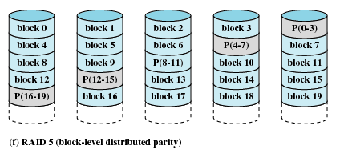
RAID 5 (Block-level distributed parity)
Having all parity strips on one disk may make it a bottleneck. Instead, we can distribute the parity strips among the disks
If a single disk fails, the system can regenerate the data lost
Reliable. Good performance with special hardware
31

Slide 32
Block-oriented disk
Disk is block-oriented. One sector is read/written at a time.
In PC, a sector is 512 bytes
The term cache memory is usually used to apply to a memory that is smaller and …
while (!feof(F)) {
// read one char
fscanf(F, “%c”, &c);
…
}
32

Slide 33
Disk Cache
Buffer in main memory for disk sectors
Contains a copy of some of the sectors
The term cache memory is usually used to apply to a memory that is smaller and …
The term cache memory
…
…
memory that is smaller
Disk I/O requests
Disk cache
Disk
33

Slide 34
Disk Cache, Hit and Miss
When an I/O request is made for a particular sector, the OS checks whether the sector is in the disk cache.
If so, (cache hit), the request is satisfied via the cache.
If not (cache miss), the requested sector is read into the disk cache from the disk.
34

Slide 35
Disk Cache, Replacement
Least Recently Used (LRU)
Replace the block that has been in the cache the longest with no reference
Least Frequently Used (LFU)
Replace the blocks in the set that has experienced the fewest references
35

Slide 36

Next Topic
File Management
Read Ch. 12

